Slide 1
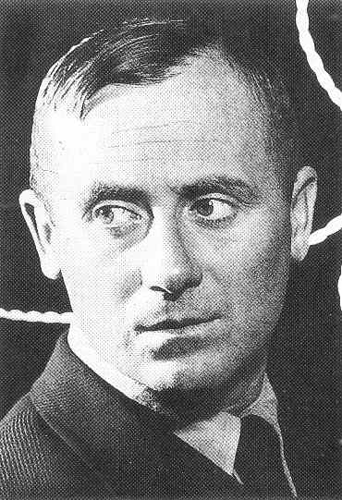
Joan Miro’
“I try to apply colors like words that shape poems, like notes that shape music.” –Joan Miro
April 20, 1893 – December 25, 1983

Slide 2
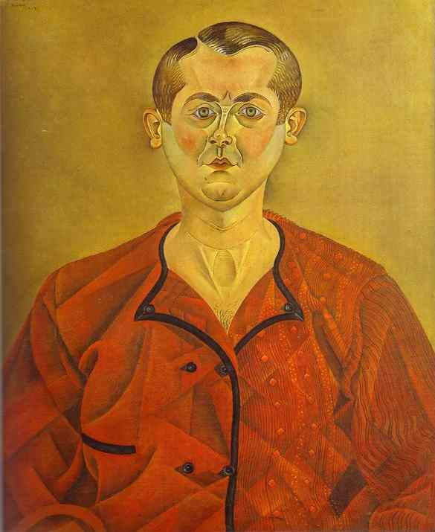
Self-Portrait
1919
Oil on canvas

Slide 3
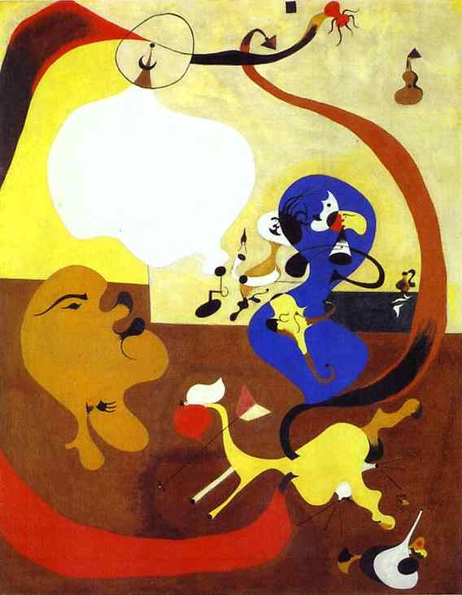
Dutch Interior II
1928
Oil on canvas

Slide 4
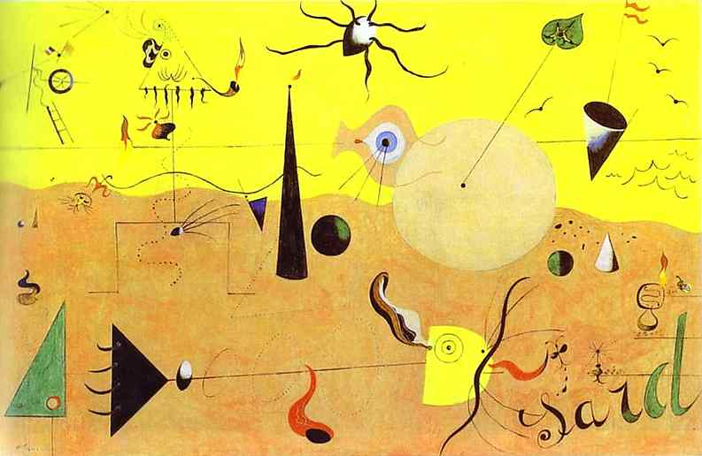
Catalan Landscape (The Hunter)
1923/24
Oil on canvas

Slide 5
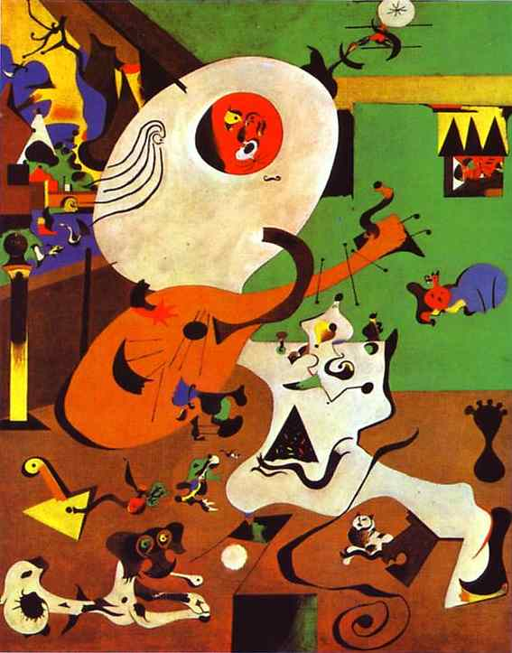
Dutch Interior I
1928
Oil on canvas

Slide 6
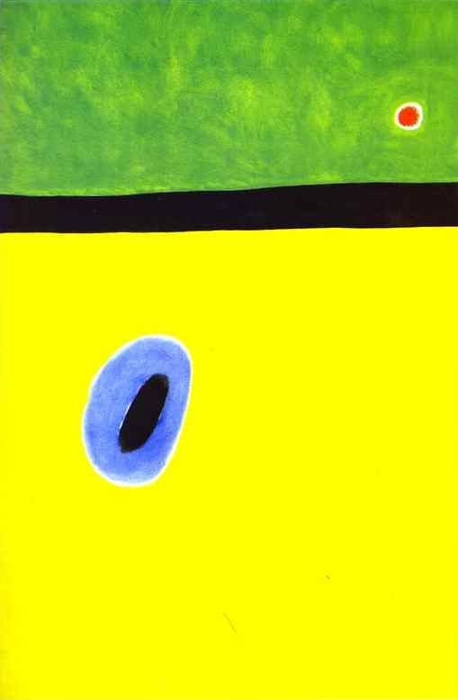
The Lark's Wing, Encircled with Golden Blue, Rejoins the Heart of the Poppy Sleeping on a Diamond-Studded Meadow
1967
Oil on canvas

Slide 7
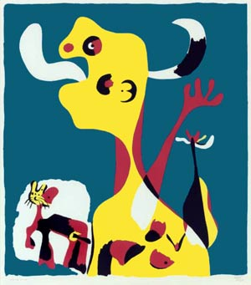

Slide 8
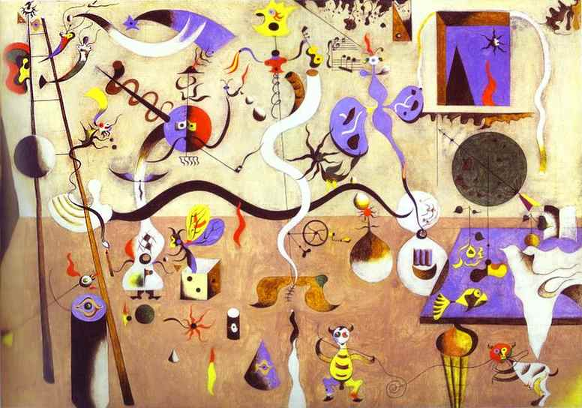
Harlequin's Carnival
1924-25
Oil on canvas

Slide 9
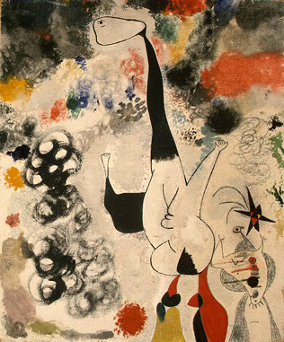

Slide 10
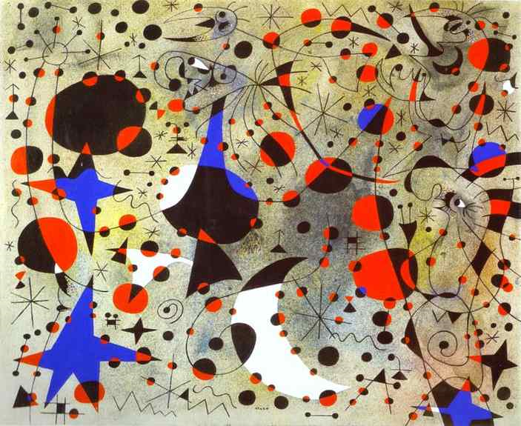
The Nightingale's Song at Midnight and the Morning Rain
1940
Gouache and turpentine paint on paper

Slide 11
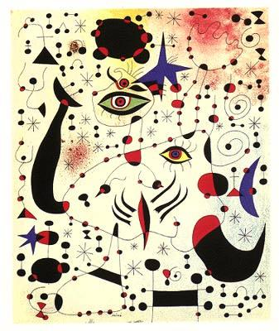
Ciphers and Constellations, in Love with a Woman
1941
Gouache and turpentine on paper

Slide 12
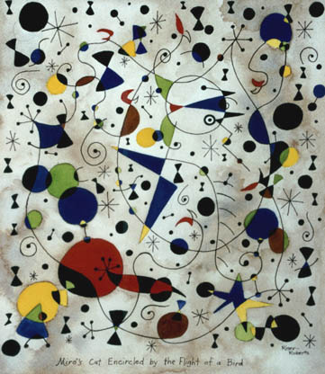

Slide 13
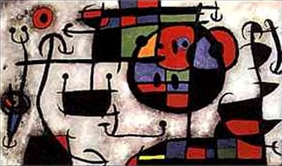

Slide 14
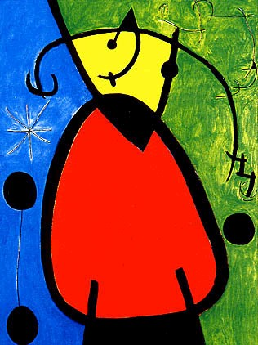

Slide 15
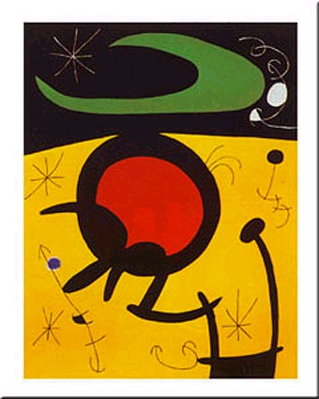

Slide 16
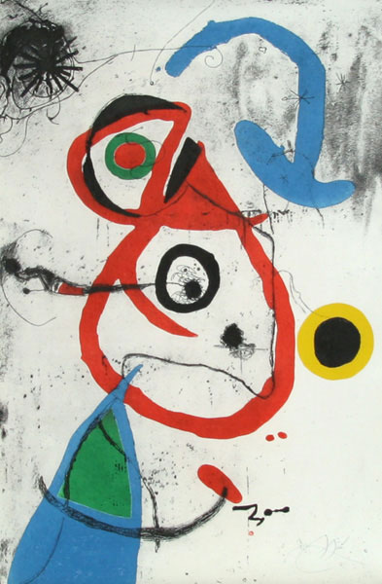

Slide 17
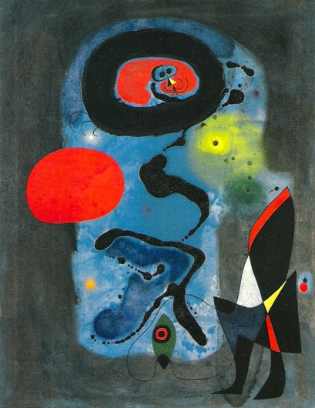

Slide 18
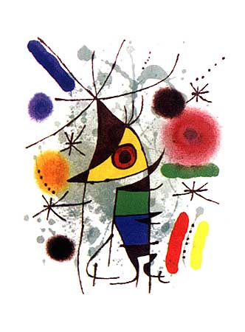

Slide 19
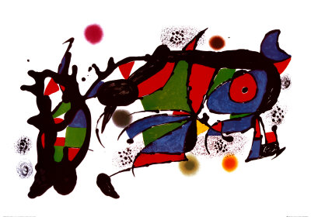

Slide 20
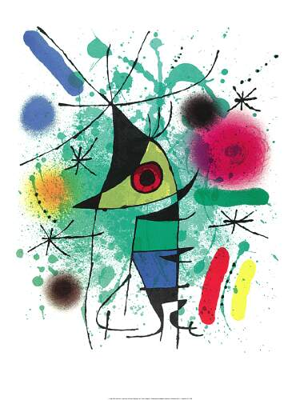

Slide 21
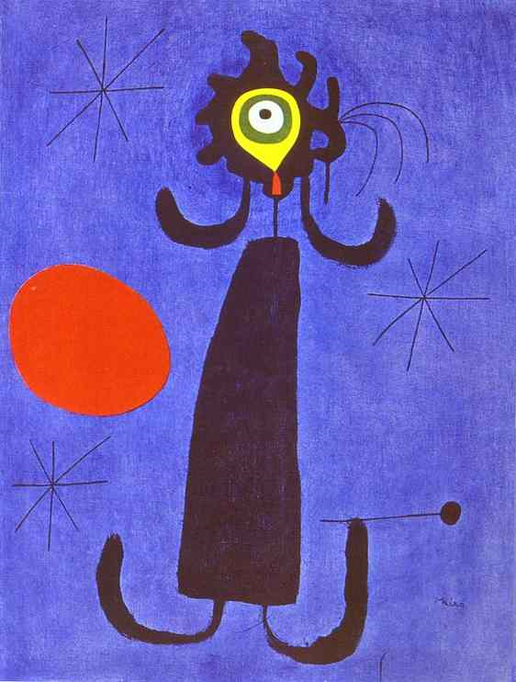
Woman in Front of the Sun
1950
Oil on canvas

Slide 22
